Slide 1
Lecture 10
Steps to create Microsoft Azure VM
Instructor : Engr. Tehmeed

Slide 2
Introduction
Azure virtual machines (VMs) can be created through the Azure portal. This method provides a browser-based user interface to create VMs and their associated resources. This quickstart shows you how to use the Azure portal to deploy a virtual machine (VM) in Azure that runs Windows Server 2022 Datacenter. To see your VM in action, you then RDP to the VM and install the IIS web server.
If you don't have an Azure subscription, create a free account before you begin

Slide 3
Steps to create Azure Virtual Machine
Sign in to Azure
Sign in to the Azure portal.
Create virtual machine
Enter virtual machines in the search.
Under Services, select Virtual machines.
In the Virtual machines page, select Create and then Azure virtual machine. The Create a virtual machine page opens.
Under Instance details, enter myVM for the Virtual machine name and choose Windows Server 2022 Datacenter: Azure Edition - x64 Gen 2 for the Image. Leave the other defaults.

Slide 4
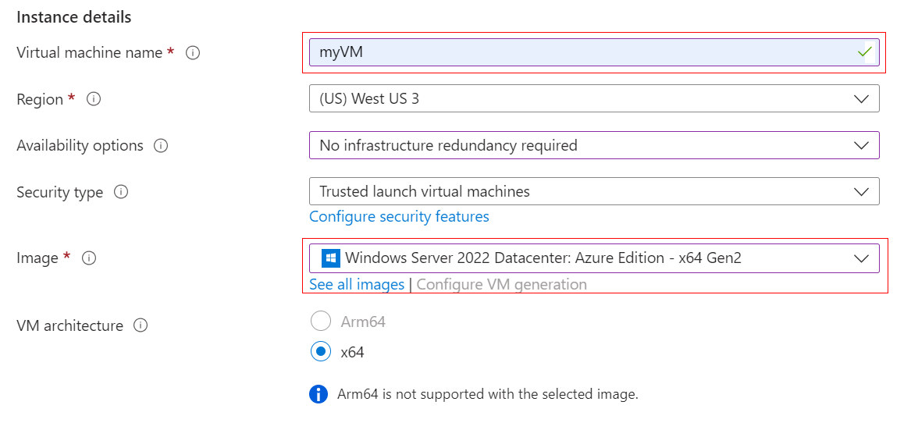
Steps to create Azure Virtual Machine

Slide 5
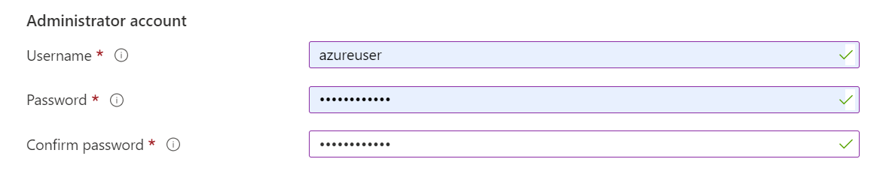
Steps to create Azure Virtual Machine
5.Under Administrator account, provide a username, such as azureuser and a password. The password must be at least 12 characters long and meet the defined complexity requirements.

Slide 6
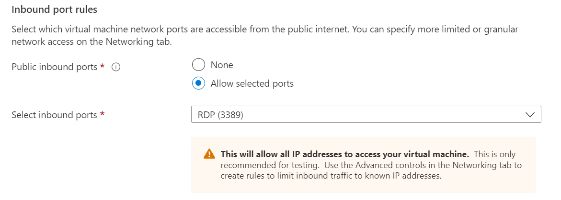
Steps to create Azure Virtual Machine
6.Under Inbound port rules, choose Allow selected ports and then select RDP (3389) and HTTP (80) from the drop-down.

Slide 7
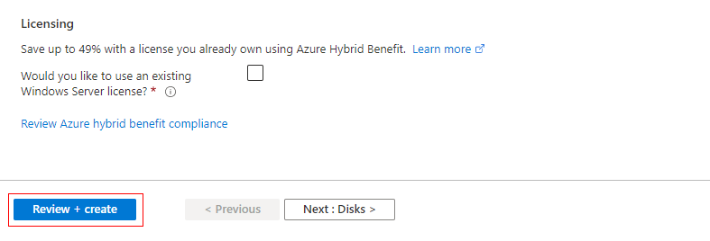
Steps to create Azure Virtual Machine
7. Leave the remaining defaults and then select the Review + create button at the bottom of the page.

Slide 8
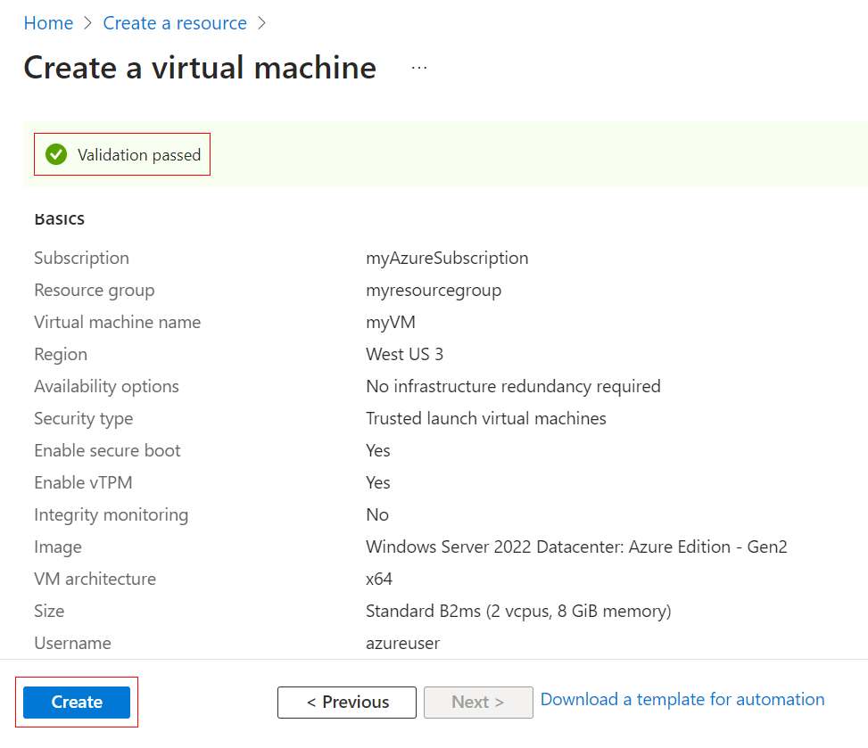
Steps to create Azure Virtual Machine
8. After validation runs, select the Create button at the bottom of the page.

Slide 9
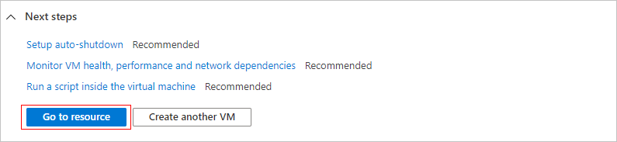
Steps to create Azure Virtual Machine
9. After deployment is complete, select Go to resource.

Slide 10

Any Questions ?

